Slide 1
Week 8
More SQL – STORED PROCEDURES

Slide 2
Student Objectives
Upon completion of this video, you should be able to:
Explain the purpose of a stored procedure
List at least 2 advantages and 2 disadvantages of a stored procedure
Write a simple stored procedure in MySQL

Slide 3
Stored Procedures
A precompiled application program, written in any language such as C, C++, COBOL, Java, … that is executed in response to a SINGLE SQL CALL statement
May contain SQL statements as well as other logic statements
Little program that with SQL statements in and code, can pass in parameters
Encapsulates Business Logic
Takes complicated SQL logic and makes it easier to execute
Useful mainly in CLIENT/SERVER applications

Slide 4
SITUATION: Suppose you need to update the salary of all 100,000 employees in your database, by 6.25%. You are working in Sydney, Australia with a java application on your desktop, the database is in New York City. What problems can you foresee?
QUESTION: What do you do to solve this problem?
ANSWER: Use a Stored Procedure!

Slide 5
Advantages of Stored Procedures
Typically faster, because the code for the stored procedure is compiled
Reduce traffic between application and database because it only has to send the name of procedure, not long and multiple SQL statements
Reusable
Secure – DBA can grant permissions to them without giving permissions to the underlying tables.

Slide 6
Disadvantages of Stored Procedures
Over usage (using MANY stored procedures) can actually slow down the application (increased load on database server).
Sometimes doesn’t allow for complex business logic
Hard to debug
Migrating to another Database System can be tricky.

Slide 7
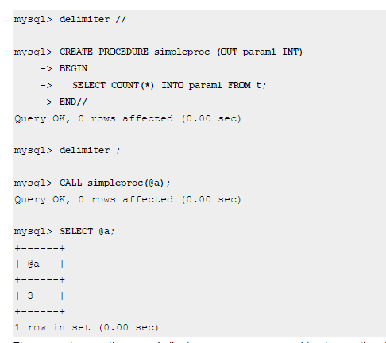
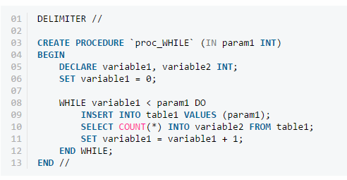
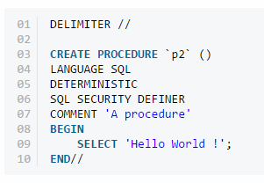
Examples from MySQL – Let’s Try it OUT

